Slide 1
Wave Motion and Sound I
PHYS1112
Lecture 16

Slide 2
Intended Learning Outcomes
After this lecture you will learn:
types of waves – longitudinal and transverse
mathematical description of waves – wave equation and wavefunction
power propagation in waves
reflection of traveling wave under open and fixed boundary conditions

Slide 3
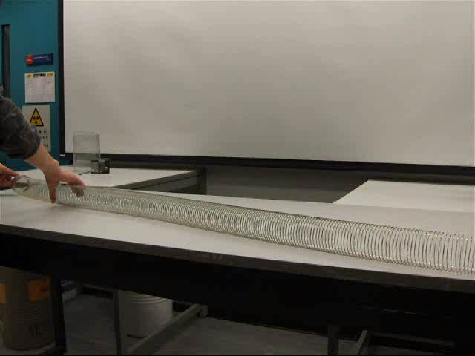

Types of waves:
Mechanical waves – need a medium for propagation
a traveling wave transports energy, but not mass of the medium

Slide 4
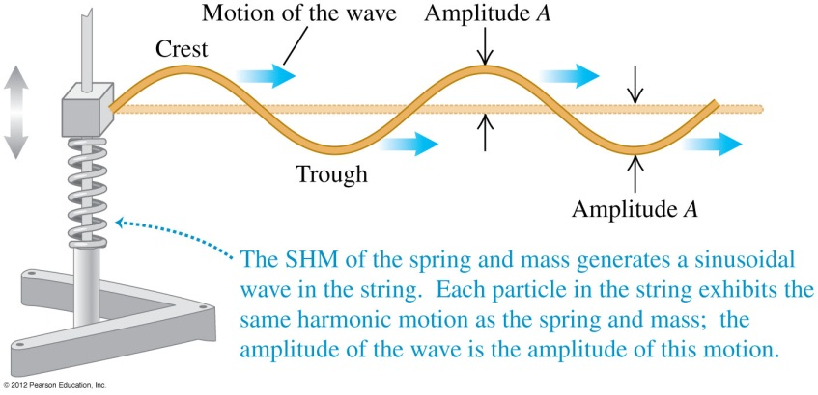
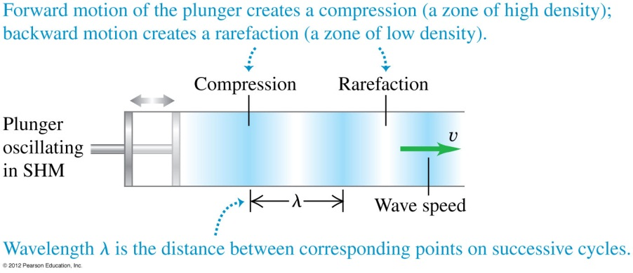
transverse,
e.g. wave in a string
longitudinal,
e.g. sound wave
Notes:
Answer: C

Slide 5
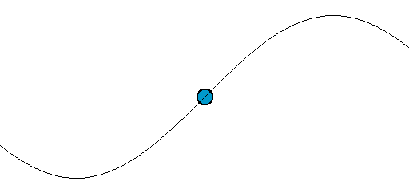
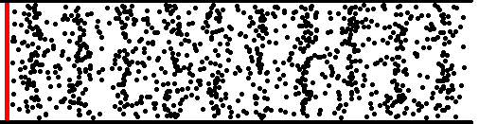
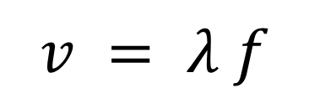
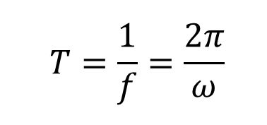
$$v = λ f$$
$$T=\frac{1}{f}=\frac{2π}{ω}$$
period
frequency
wave speed
wavelength
Notes:
Answer: C

Slide 6

Mathematical description

Slide 7
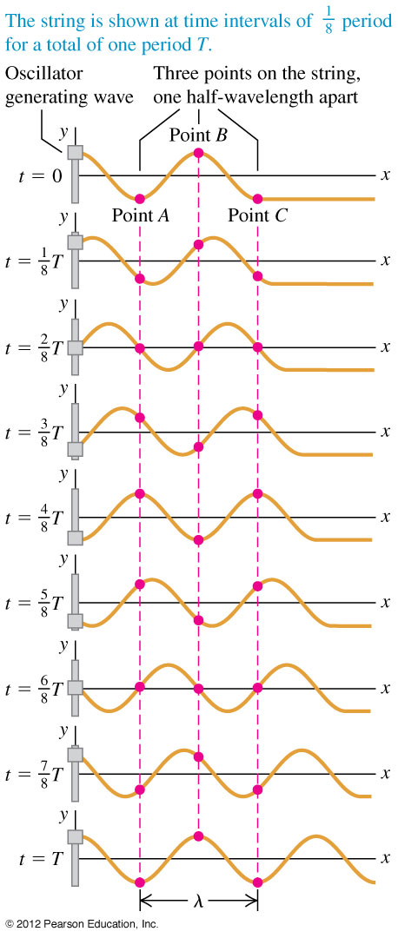
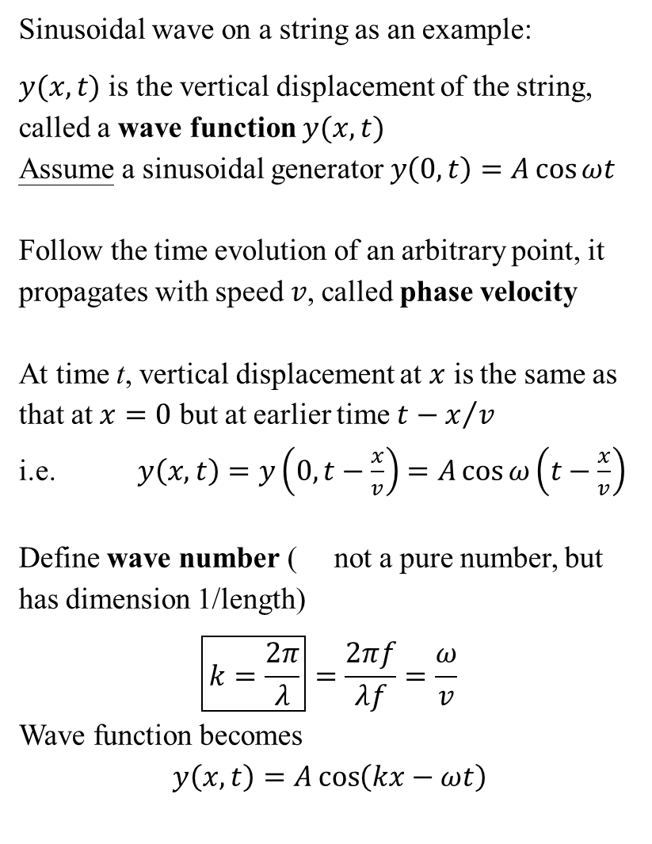
Sinusoidal wave on a string as an example:
$y(x,t)$ is the vertical displacement of the string, called a wave function $y(x,t)$
Assume a sinusoidal generator $y\left(0,t\right)=A\cos{ωt}$
Follow the time evolution of an arbitrary point, it propagates with speed $v$, called phase velocity
At time t, vertical displacement at $x$ is the same as that at $x=0$ but at earlier time $t−x/v$
i.e. $y\left(x,t\right)=y\left(0,t−\frac{x}{v}\right)=A\cos{ω\left(t−\frac{x}{v}\right)}$
Define wave number ( not a pure number, but has dimension 1/length)
$$\boxed{k=\frac{2π}{λ}}=\frac{2πf}{λf}=\frac{ω}{v}$$
Wave function becomes
$$y\left(x,t\right)=A\cos\left(kx−ωt\right)$$

Slide 8
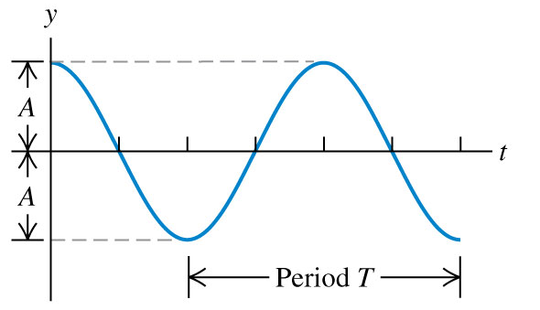
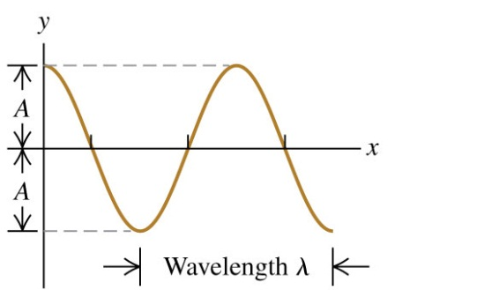
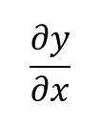
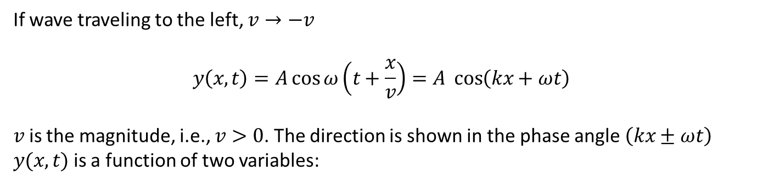
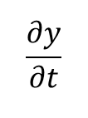
If wave traveling to the left, $v→−v$
$$y\left(x,t\right)=A\cos{ω\left(t+\frac{x}{v}\right)}=A \cos\left(kx+ωt\right)$$
$v$ is the magnitude, i.e., $v>0$. The direction is shown in the phase angle $\left(kx±ωt\right)$
$y(x,t)$ is a function of two variables:
displacement of a particular point on the string – x is fixed
a snapshot (or photo) of the wave motion – t is fixed
$$\frac{∂y}{∂t}$$
$$\frac{∂y}{∂x}$$
slope is
slope is

Slide 9
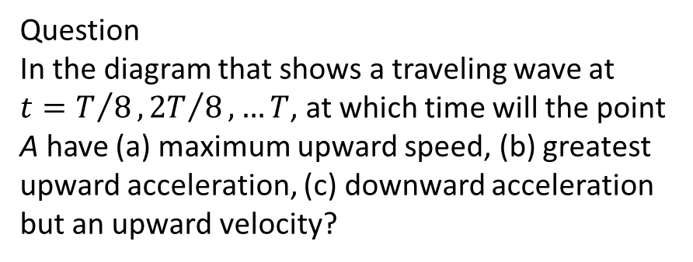
Question
In the diagram that shows a traveling wave at $t=T/8, {2T}/8, …T$, at which time will the point A have (a) maximum upward speed, (b) greatest upward acceleration, (c) downward acceleration but an upward velocity?
Notes:
Answer: C

Slide 10
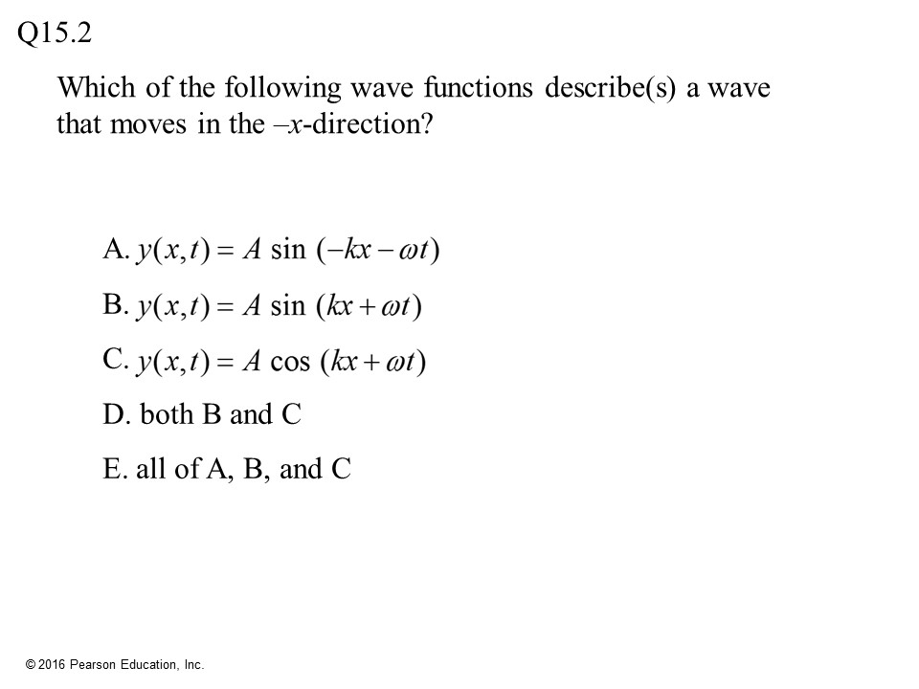

Slide 11
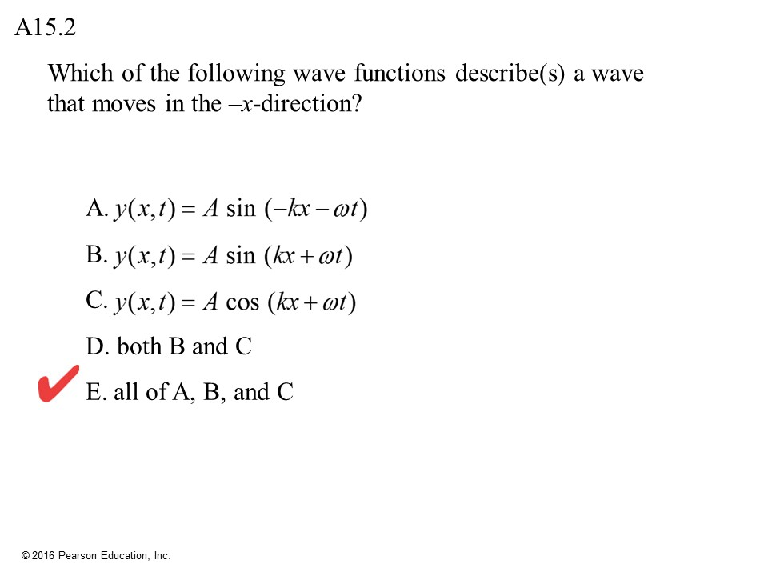

Slide 12
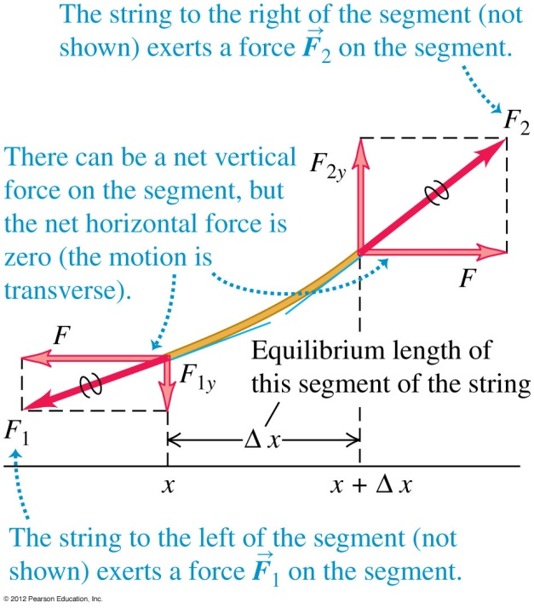
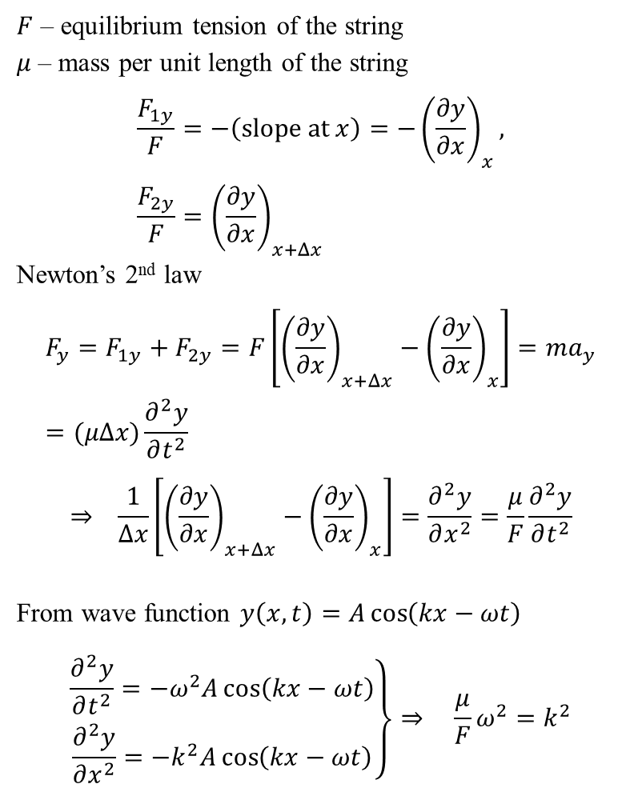
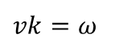
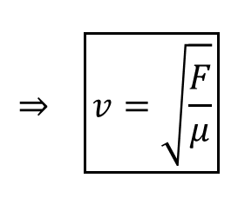
Wave equation
$F$ – equilibrium tension of the string
$μ$ – mass per unit length of the string
$$\frac{F_{1y}}{F}=−\left(\text{slope} \text{at} x\right)=−{\left(\frac{∂y}{∂x}\right)}_{x}, \frac{F_{2y}}{F}={\left(\frac{∂y}{∂x}\right)}_{x+Δx}$$
Newton’s 2nd law
$$F_{y}=F_{1y}+F_{2y}=F\left[{\left(\frac{∂y}{∂x}\right)}_{x+Δx}−{\left(\frac{∂y}{∂x}\right)}_{x}\right]=ma_{y}=(μΔx)\frac{∂^{2}y}{∂t^{2}}$$
$$⇒ \frac{1}{Δx}\left[{\left(\frac{∂y}{∂x}\right)}_{x+Δx}−{\left(\frac{∂y}{∂x}\right)}_{x}\right]=\frac{∂^{2}y}{∂x^{2}}=\frac{μ}{F}\frac{∂^{2}y}{∂t^{2}}$$
From wave function $y\left(x,t\right)=A\cos\left(kx−ωt\right)$
$$\left.\begin{matrix}\frac{∂^{2}y}{∂t^{2}}=−ω^{2}A\cos\left(kx−ωt\right) \\ \frac{∂^{2}y}{∂x^{2}}=−k^{2}A\cos\left(kx−ωt\right)\end{matrix}\right\}⇒ \frac{μ}{F}ω^{2}=k^{2}$$
$$⇒ \boxed{v=\sqrt{\frac{F}{μ}}}$$
wave speed on a string
$vk=ω$
Notes:
Answer: D

Slide 13
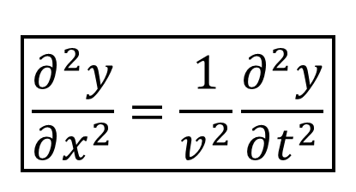
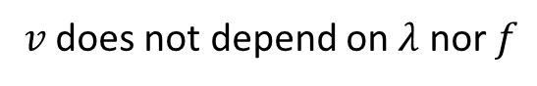
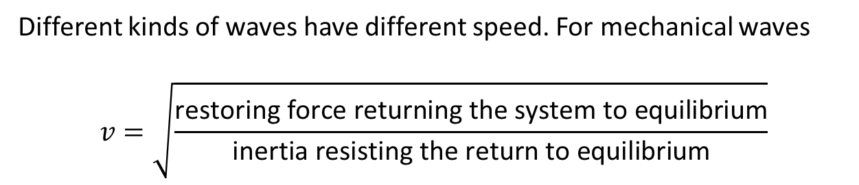
∴ wavefunctions are solutions of the wave equation
$$\boxed{\frac{∂^{2}y}{∂x^{2}}=\frac{1}{v^{2}}\frac{∂^{2}y}{∂t^{2}}}$$
D’Alembert’s equation,
hold for different kinds of waves
Different kinds of waves have different speed. For mechanical waves
$$v=\sqrt{\frac{\text{restoring} \text{force} \text{returning} \text{the} \text{system} \text{to} \text{equilibrium}}{\text{inertia} \text{resisting} \text{the} \text{return} \text{to} \text{equilibrium}}}$$
$v$ does not depend on $λ$ nor $f$

Slide 14
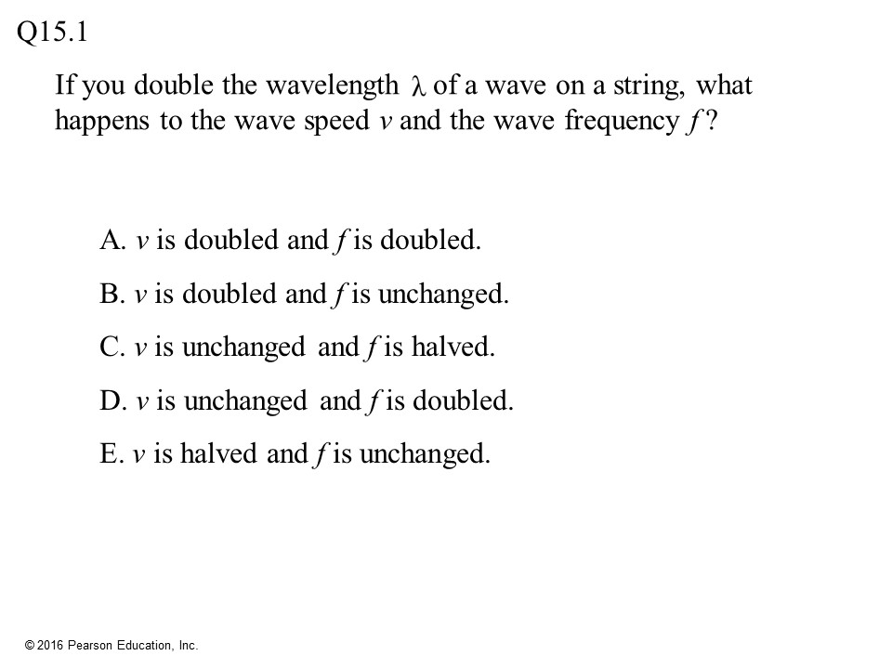

Slide 15
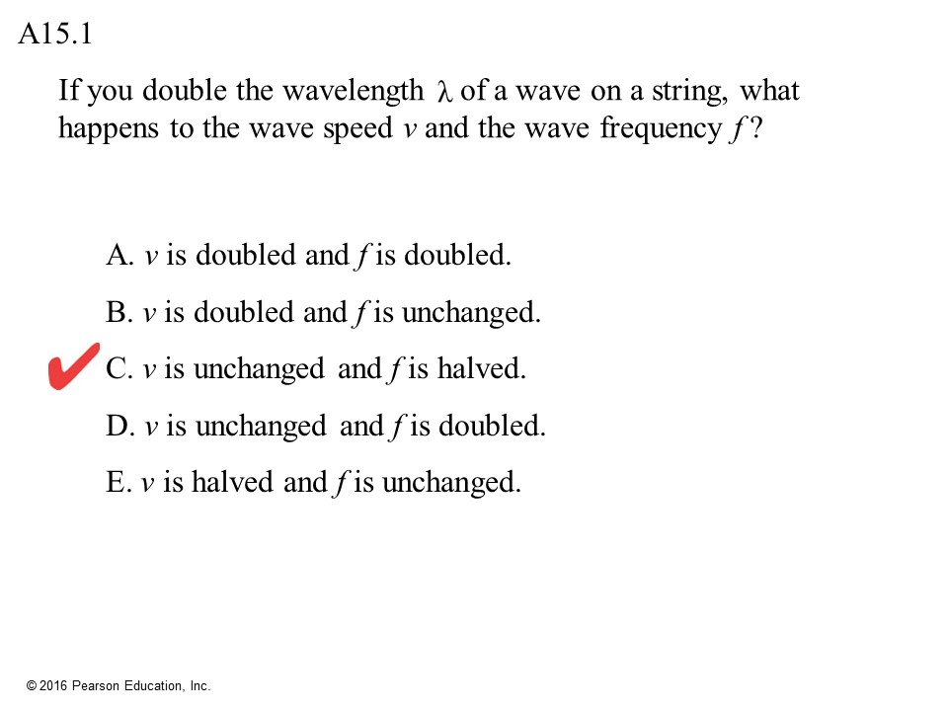

Slide 16
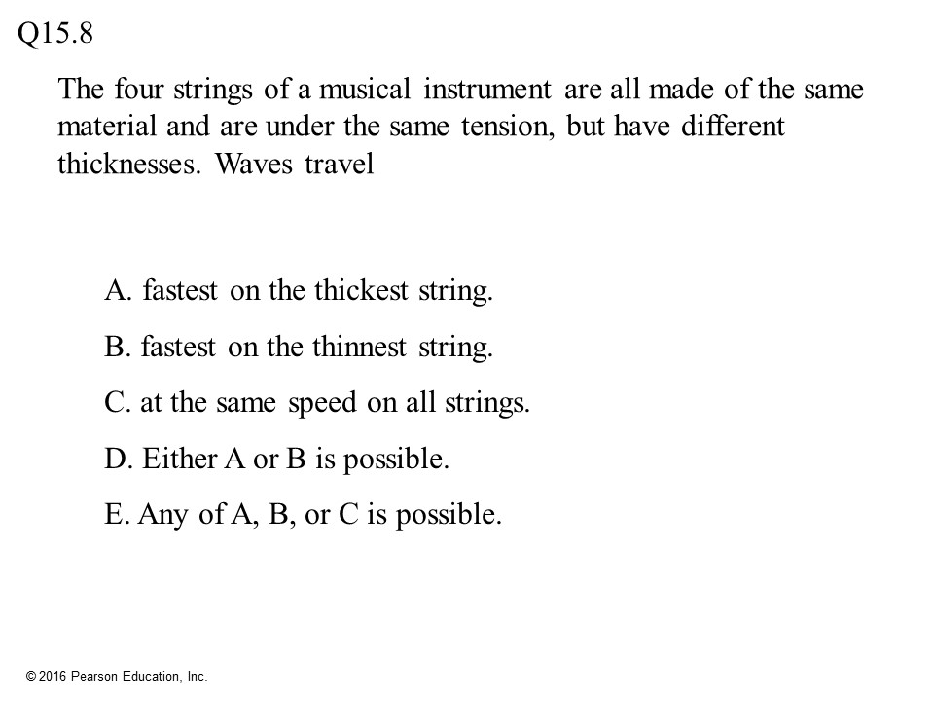

Slide 17
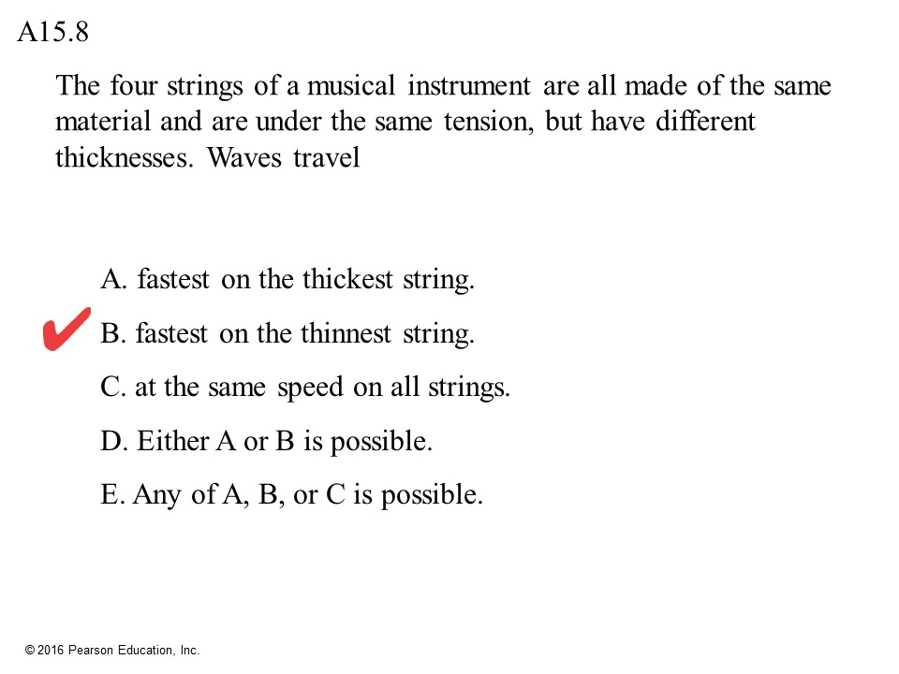

Slide 18
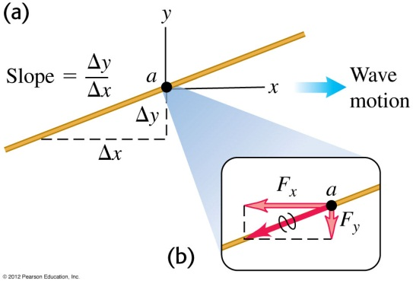
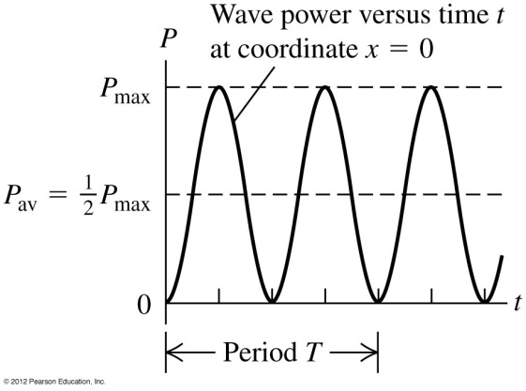
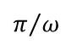
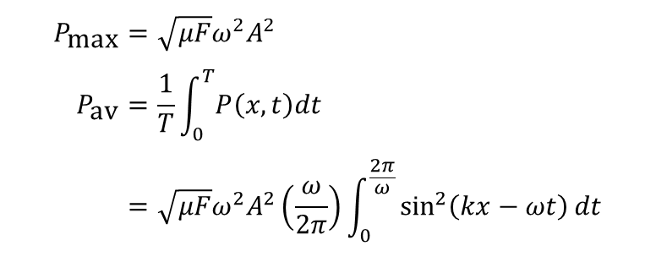
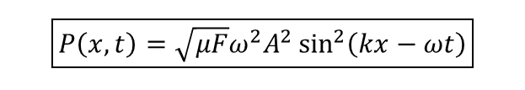
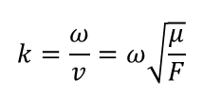
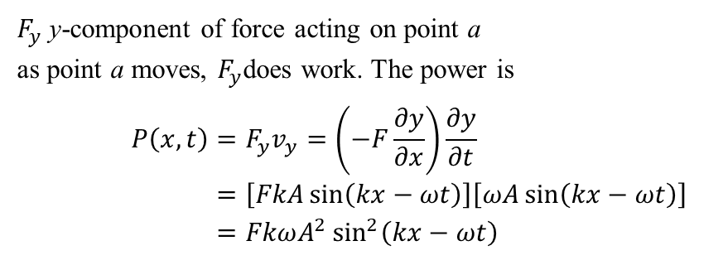
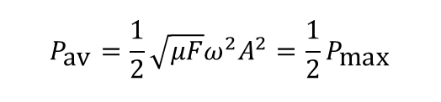
Que: Is there anything propagating, besides the shape? Ans: Yes, energy.
To see why consider a vibrating string
$F_{y}$ y-component of force acting on point a
as point a moves, $F_{y}$does work. The power is
$$P\left(x,t\right)=F_{y}v_{y}=\left(−F\frac{∂y}{∂x}\right)\frac{∂y}{∂t} \\ =\left[FkA\sin\left(kx−ωt\right)\right]\left[ωA\sin\left(kx−ωt\right)\right] \\ =FkωA^{2}\sin^{2}\left(kx−ωt\right)$$
$$k=\frac{ω}{v}=ω\sqrt{\frac{μ}{F}}$$
$$\boxed{P\left(x,t\right)=\sqrt{μF}ω^{2}A^{2}\sin^{2}\left(kx−ωt\right)}$$
$$P_{\text{max}}=\sqrt{μF}ω^{2}A^{2} \\ P_{\text{av}}=\frac{1}{T}\int_{0}^{T}{P\left(x,t\right)dt} \\ =\sqrt{μF}ω^{2}A^{2}\left(\frac{ω}{2π}\right)\int_{0}^{\frac{2π}{ω}}{\sin^{2}\left(kx−ωt\right)dt}$$
propagating, like a wave
$$π/ω$$
$$P_{\text{av}}=\frac{1}{2}\sqrt{μF}ω^{2}A^{2}=\frac{1}{2}P_{\text{max}}$$
Notes:
Answer: C

Slide 19
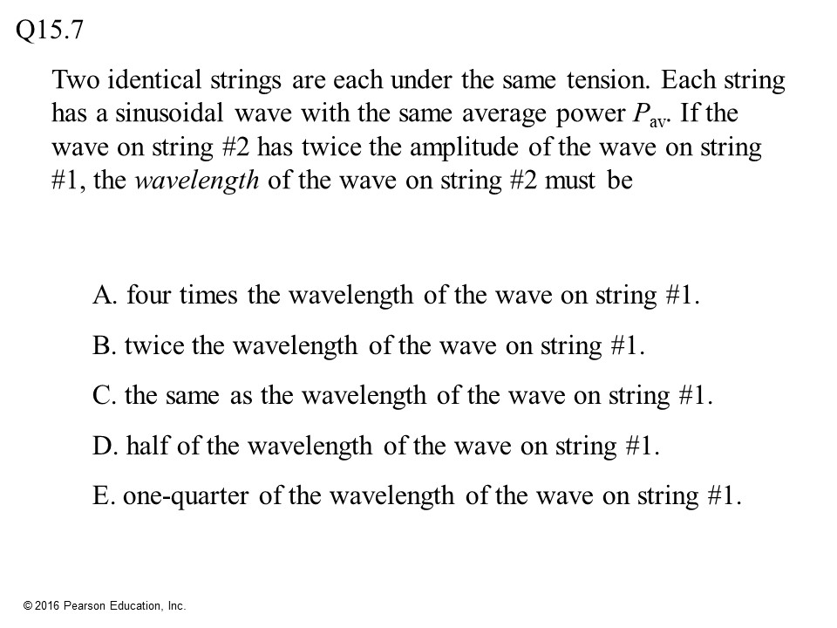

Slide 20
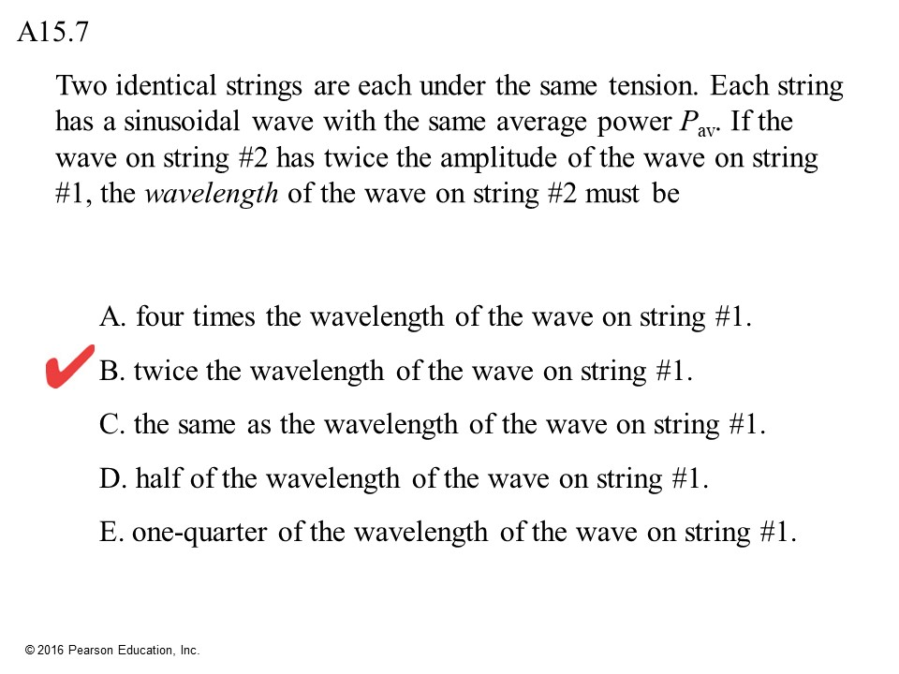

Slide 21
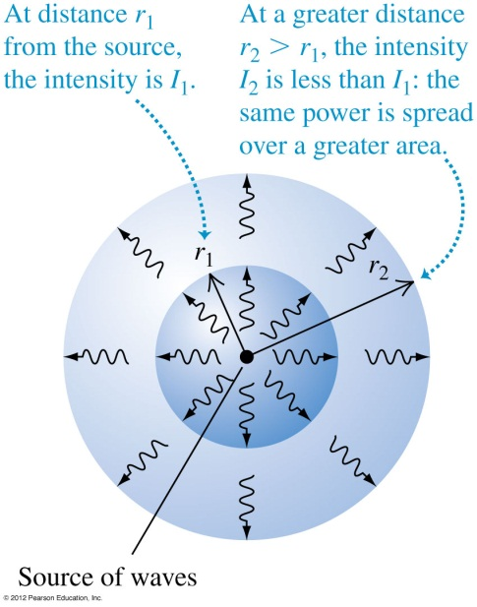
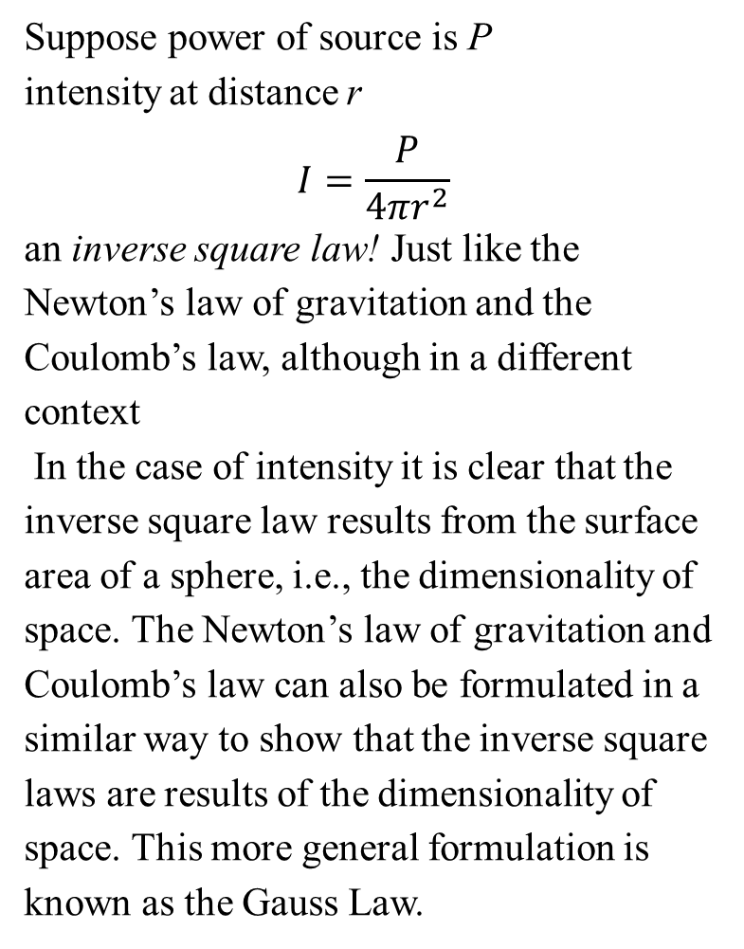
For wave in 3D, define intensity = average power per unit area, SI unit: W/m²
Suppose power of source is P
intensity at distance r
$$I=\frac{P}{4πr^{2}}$$
an inverse square law! Just like the Newton’s law of gravitation and the Coulomb’s law, although in a different context
In the case of intensity it is clear that the inverse square law results from the surface area of a sphere, i.e., the dimensionality of space. The Newton’s law of gravitation and Coulomb’s law can also be formulated in a similar way to show that the inverse square laws are results of the dimensionality of space. This more general formulation is known as the Gauss Law.

Slide 22
Wave reflection

Slide 23
Image method –proof involves solving the d’Alembert equation
Mirror image of the wave coming in opposite direction, reflected wave results from the superposition of the “real” wave and its “image”.
must observe the boundary condition
Notes:
Answer: B

Slide 24
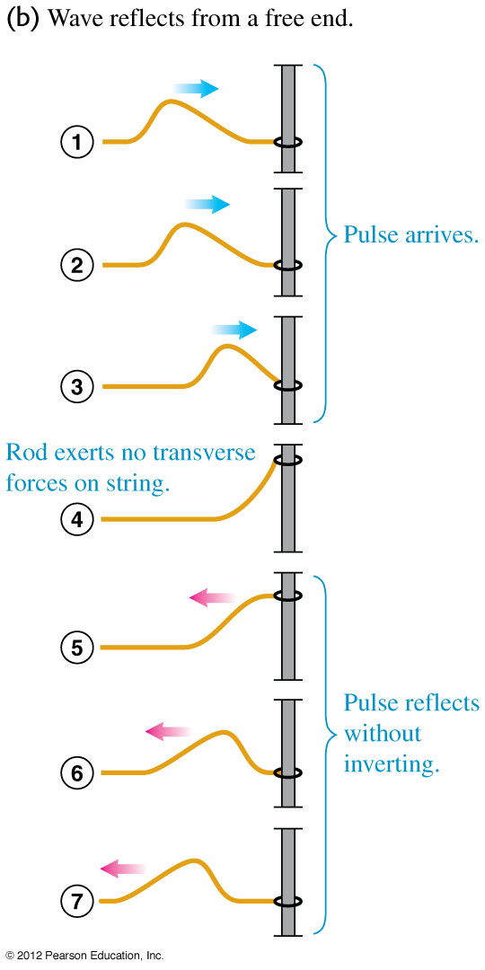
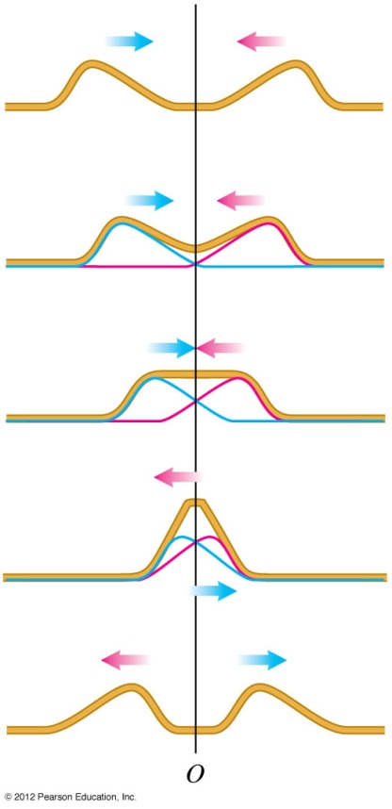
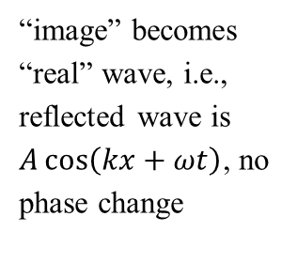
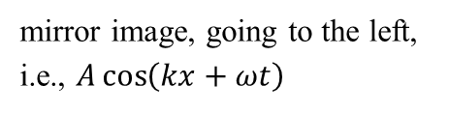
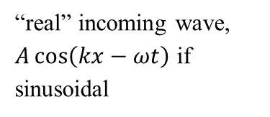
open boundary condition – free to move at one end
“real” incoming wave, $A\cos\left(kx−ωt\right)$ if sinusoidal
mirror image, going to the left, i.e., $A\cos\left(kx+ωt\right)$
image method
“image” becomes “real” wave, i.e., reflected wave is $A\cos\left(kx+ωt\right)$, no phase change
Notes:
Answer: D

Slide 25
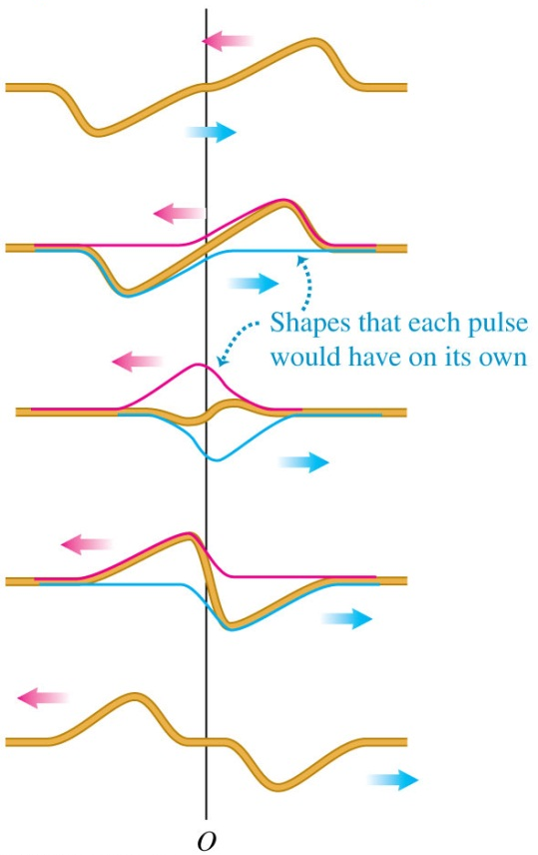
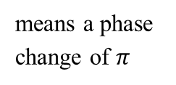
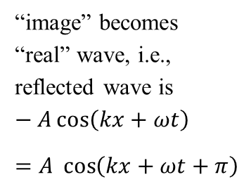
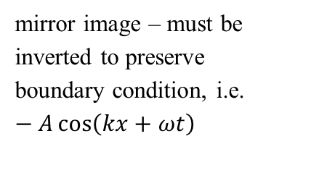

fixed boundary condition – string clamped at one end
mirror image – must be inverted to preserve boundary condition, i.e. $−A\cos\left(kx+ωt\right)$
“real” in coming wave,
$A\cos\left(kx−ωt\right)$ if sinusoidal
“image” becomes “real” wave, i.e., reflected wave is $−A\cos\left(kx+ωt\right)$
$=A \cos\left(kx+ωt+π\right)$
means a phase change of $π$

Slide 26


Slide 27


Slide 28


Slide 29


Slide 30


Slide 31


Slide 32


Slide 33


